Slide 1


DSA Kuppi 02
DATA STRUCTURES
& ALGORITHMS
SINGLY LINKED-LISTS
1

Slide 2


DSA Kuppi 02
KEY TYPES OF DATA STRUCTURES:
Linear Data Structures
Array: A collection of elements, each identified by an index.
Linked List: A sequence of nodes where each node contains data and a reference to the next node.
Stack: A collection of elements with Last-In-First-Out (LIFO) access.
Queue: A collection of elements with First-In-First-Out (FIFO) access.
Non-linear Data Structures
Tree: A hierarchical structure with nodes connected by edges, often used for hierarchical data.
Graph: A set of nodes connected by edges, which can represent various relationships.
Hash Table
A data structure that maps keys to values using a hash function for fast data retrieval.
Heaps
A specialized tree-based structure that satisfies the heap property, commonly used in priority queues.
2

Slide 3


DSA Kuppi 02
TODAY FOCUS
What is a Linked-List
Visualizing Singly Linked List
Start Building SLL
SLL Operations;
Add to end
Add to front
Add to a specific position
Remove element at specific position
Search and remove
3

Slide 4

DSA Kuppi 02
WHAT IS A SINGLY LINKED LIST?
A singly linked list is a type of data structure consisting of a sequence of nodes where each node contains two components:
Data: The value or information stored in the node.
Pointer/Link: A reference (or pointer) to the next node in the sequence.
4

Slide 5

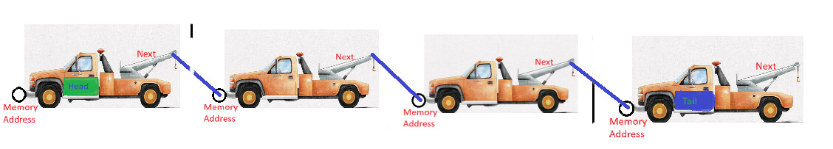
DSA Kuppi 02
VISUALIZATION
Linked List
Node
Node
Node
Node
Hobbs & Shaw (2019)
5

Slide 6

DSA Kuppi 02
OPERATIONS
Add to end
Add to front
Add to a specific position
Remove element at specific position
Search and remove
6

Slide 7


THANK
YOU!
DSA Kuppi 02
Notes + Codes
Feedback
https://github.com/Thanu10ekoon/DSA
https://thanu10ekoon.github.io/web
7

